Slide 1
Georgia Tech's Computational Photography Class
Portfolio
Hieu Nguyen
hieu@gatech.edu
https://cs6475.wordpress.com/2015-fall/

Slide 2
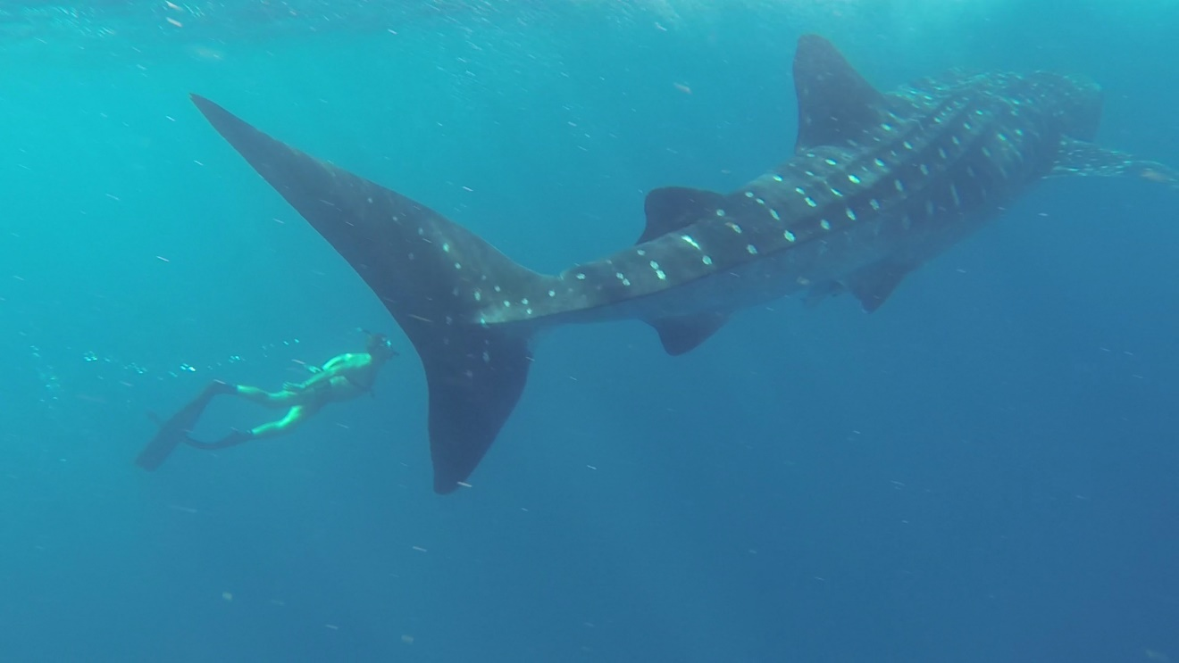
Assignment #1: A Photograph is a Photograph
“Deep Pursuit”
This photograph was shot off the coast of Isla Mujeres in Cancun, Mexico with a GoPro Hero3 camera

Slide 3
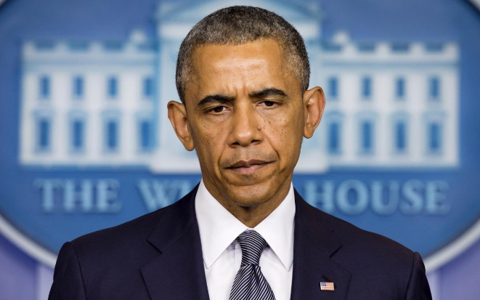
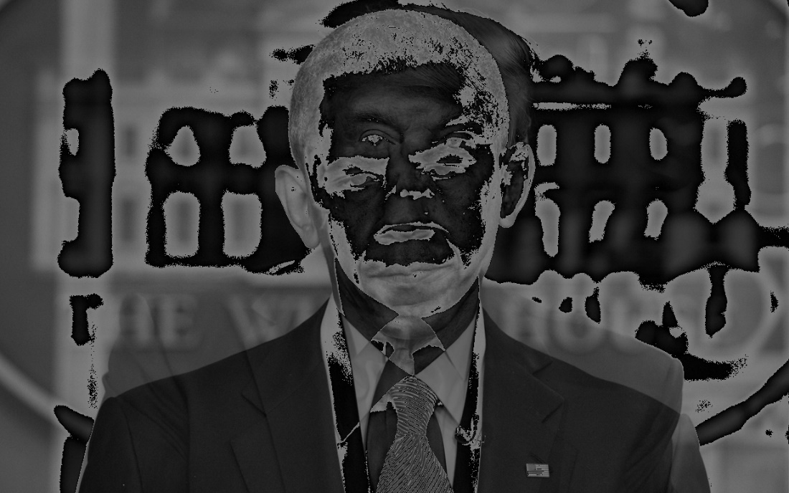

Assignment #2: Image I/O
Input:
Output:
averageTwoImages()

Slide 4
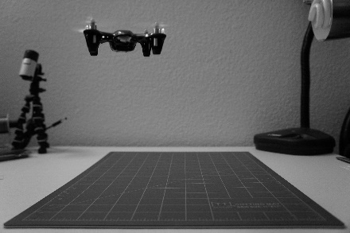
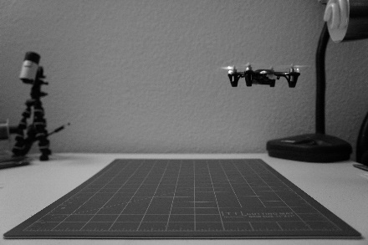
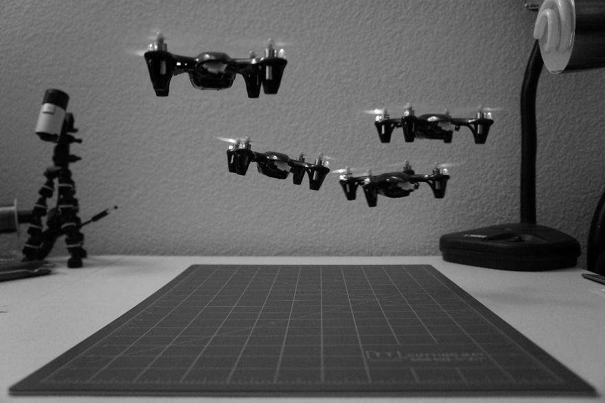
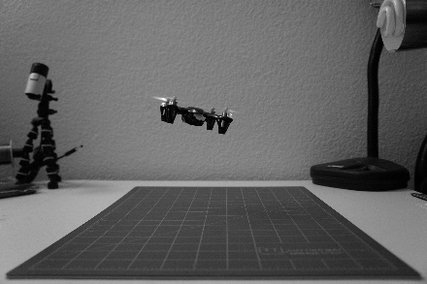
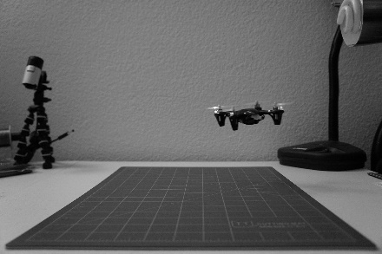
Assignment #3: Epsilon Photography
1
3
2
4
A quad of quads! This epsilon photograph captures a single quadcopter in motion. By overlaying 4 images of the quad in different positions in the three dimensional space, it appears as if there is a swarm!

Slide 5
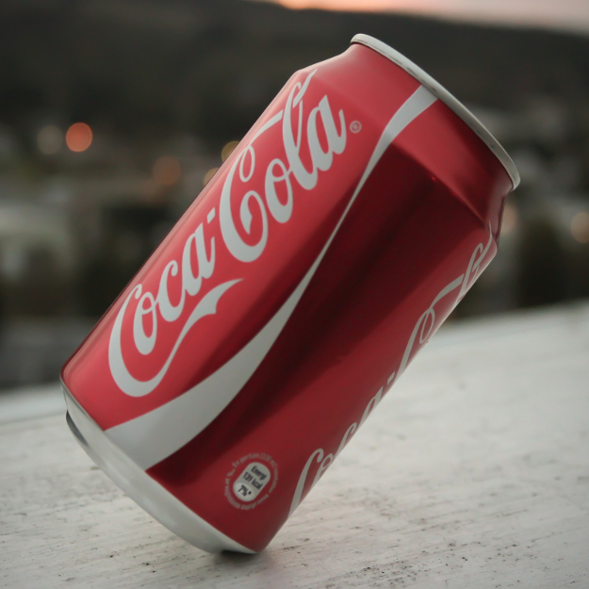
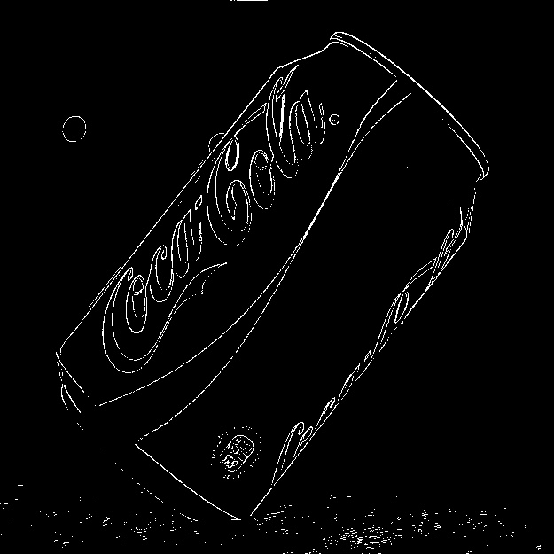
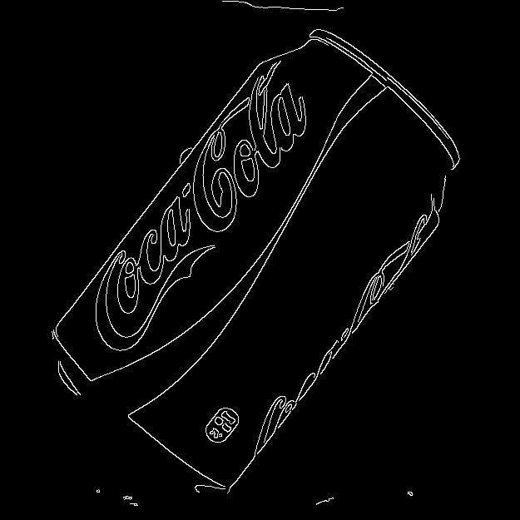
Assignment #4: Gradients and Edges
Input
Black/White Gradient
(threshold=50)
Canny Edge Detection (thr1=900, thr2=3200, apSz=5)

Slide 6
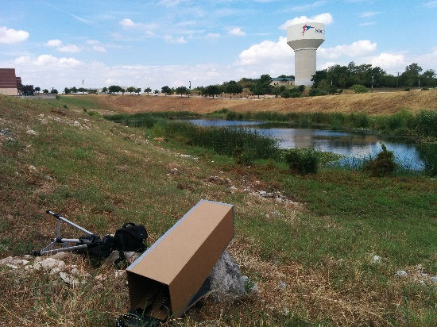
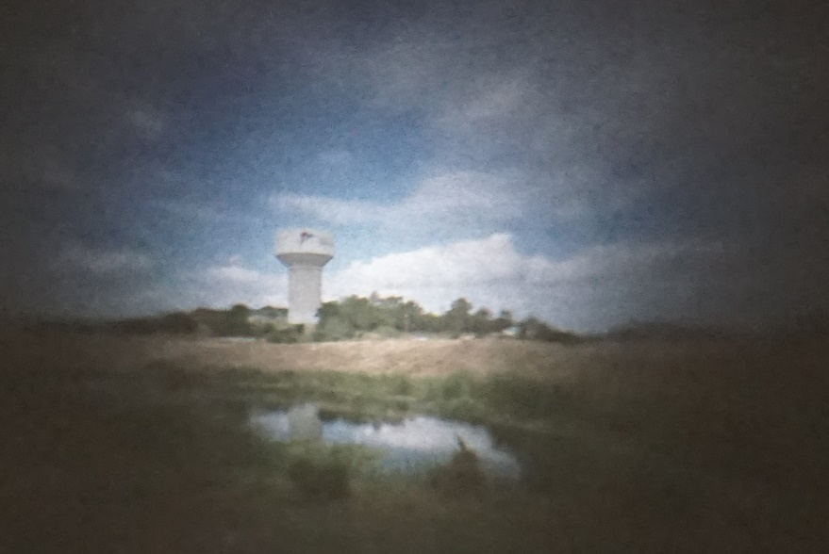
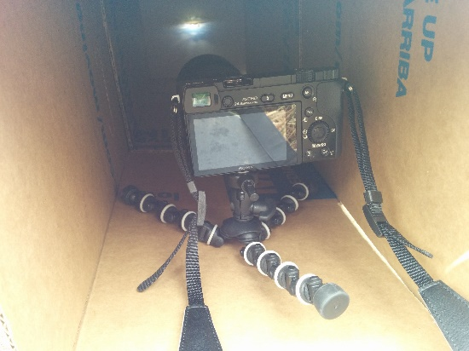
Assignment #5: Camera Obscura
Scene
Resulting Image
Setup

Slide 7
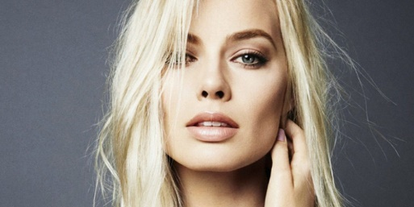



Assignment #6: Blending
White Input
Mask
Black Input
Blended Output

Slide 8
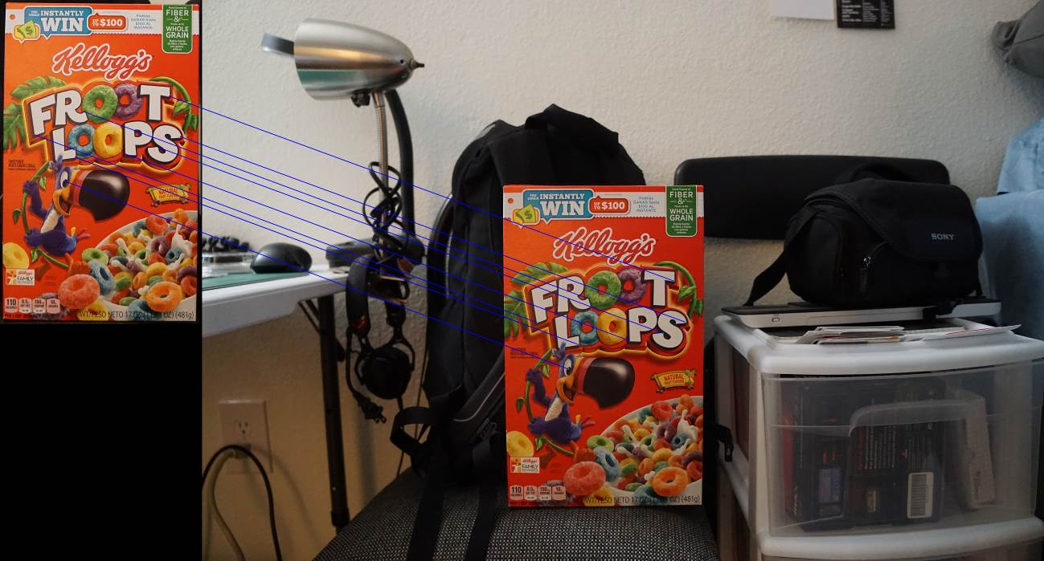
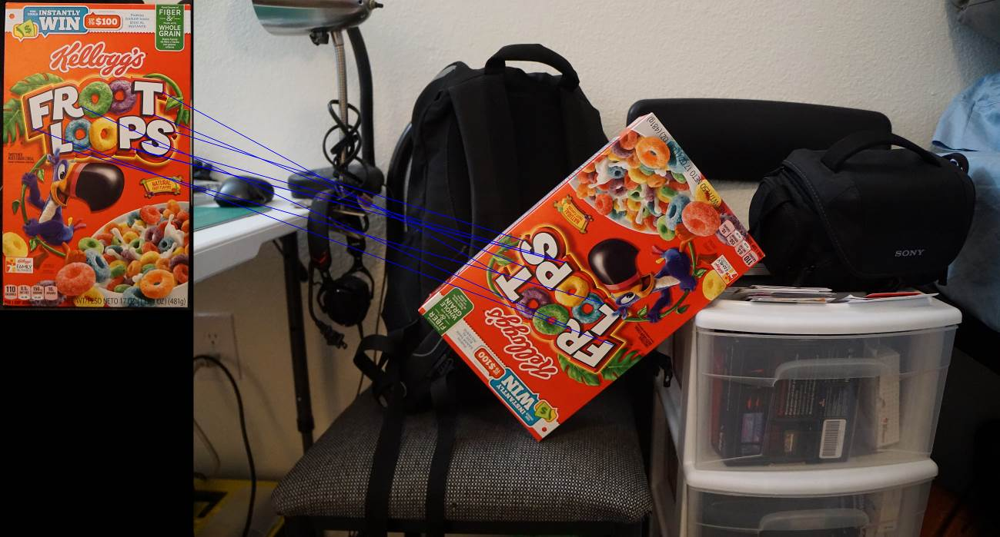
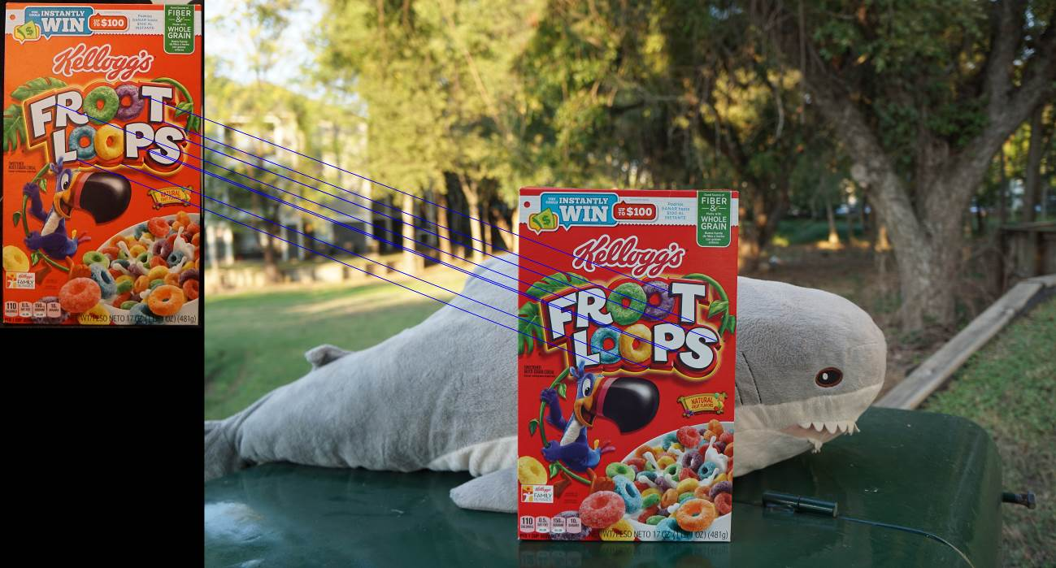
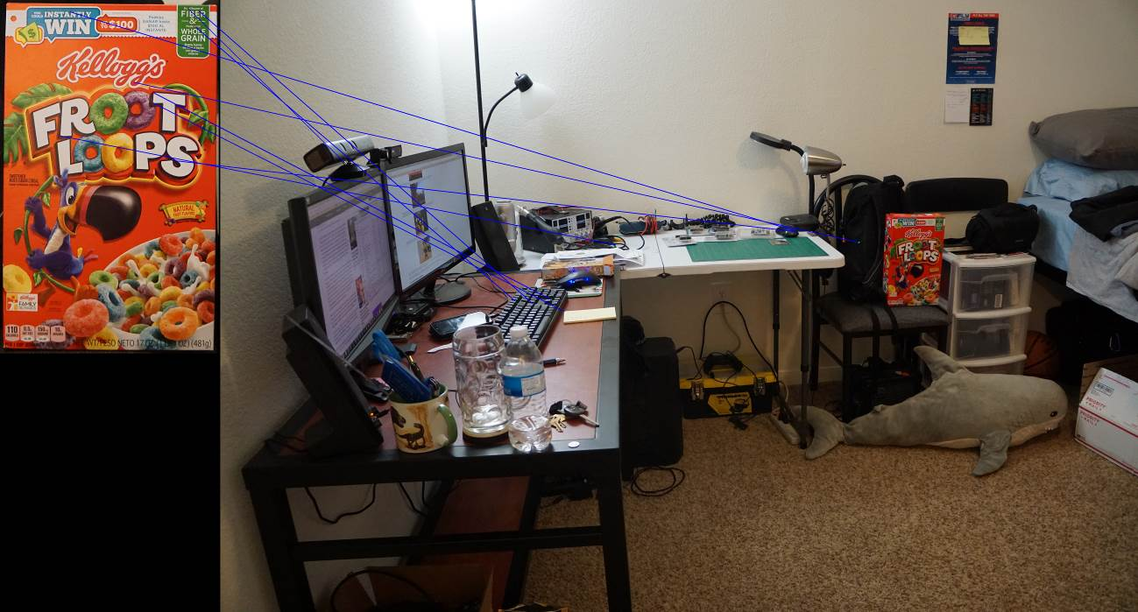
Assignment #7: Feature Detection
Indoor
Rotation
Outdoor
Far

Slide 9
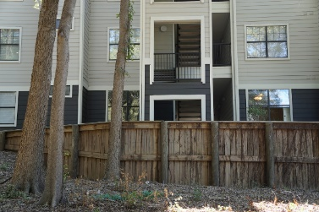
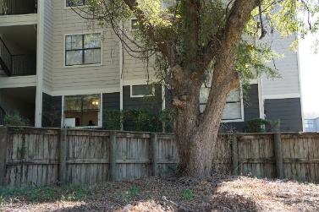
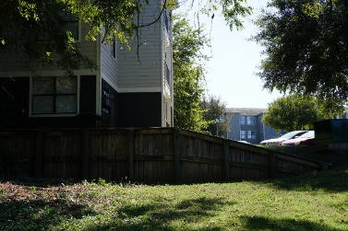
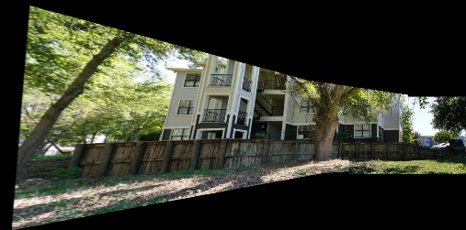
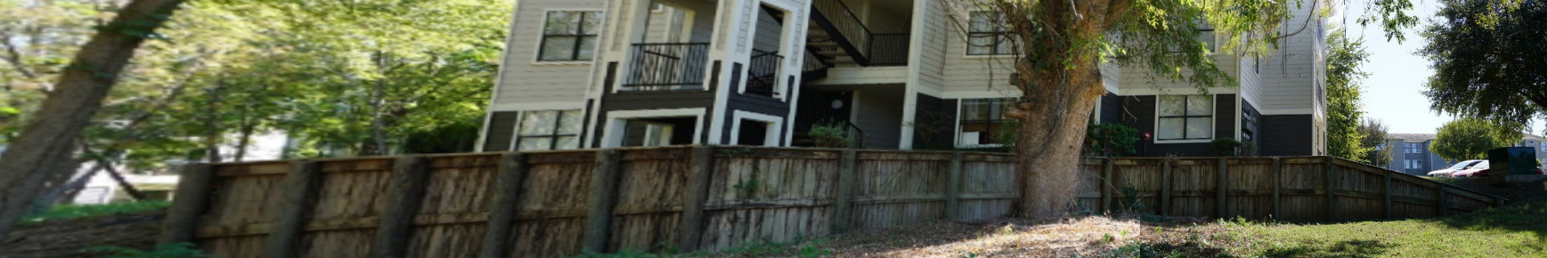
Assignment #8: Panoramas
Inputs
Stitched Panorama
Cropped Panorama

Slide 10
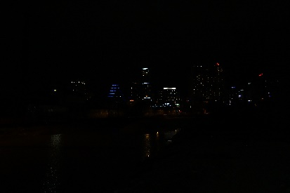
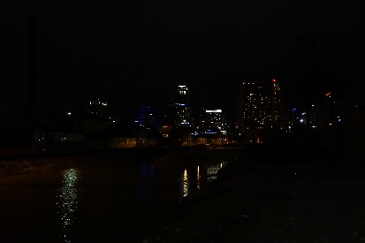
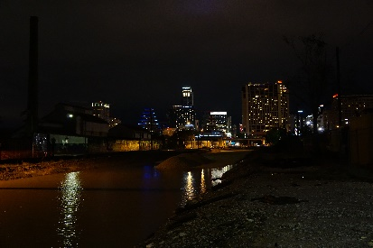
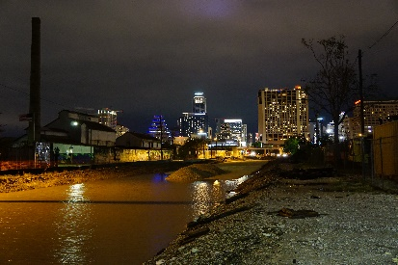
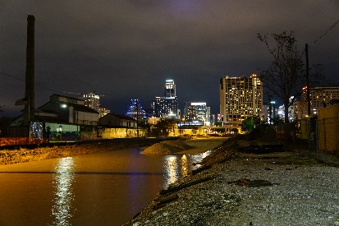
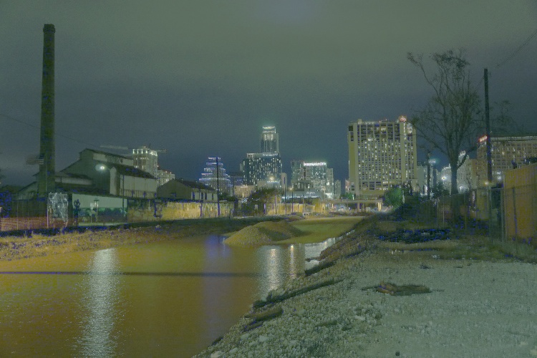
Assignment #9: HDR
Input Images with varying shutter speeds
1/125
1/50
1/15
1/5
1/2
High Dynamic Range Output

Slide 11
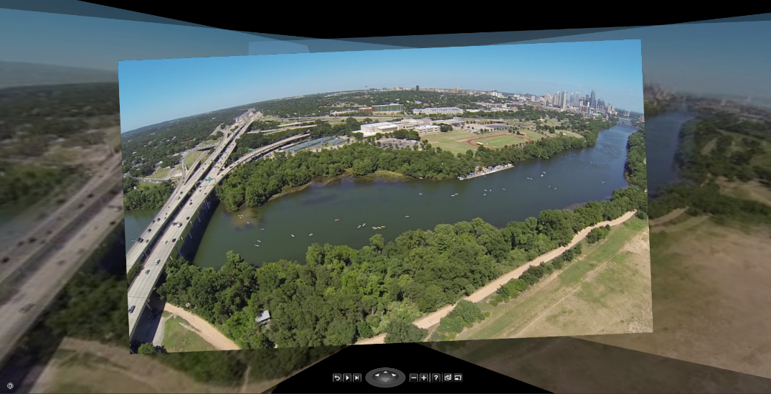
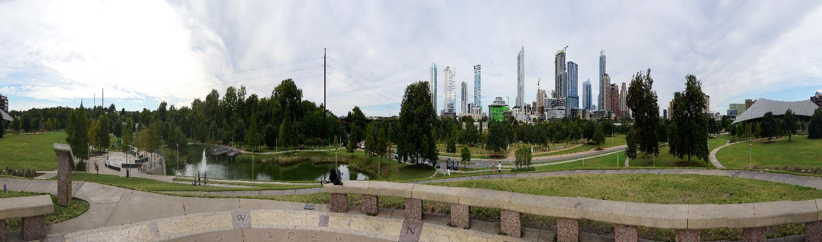
Assignment #10: Pictures of Space (1)
Legacy Photosynth of Austin Skyline, 29 photos.
Panorama at Doug Sahm Hill, 23 photos. Microsoft ICE.

Slide 12
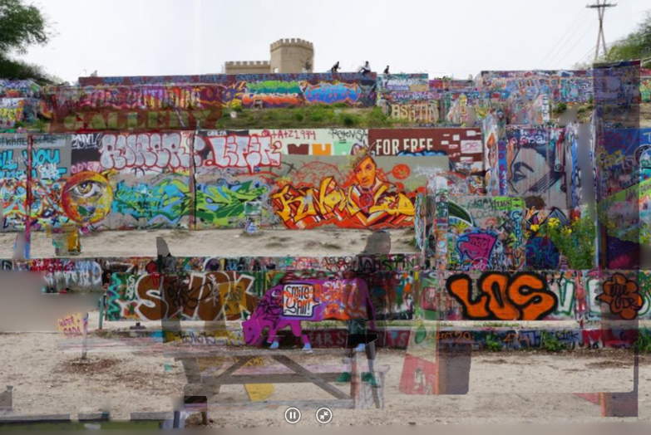
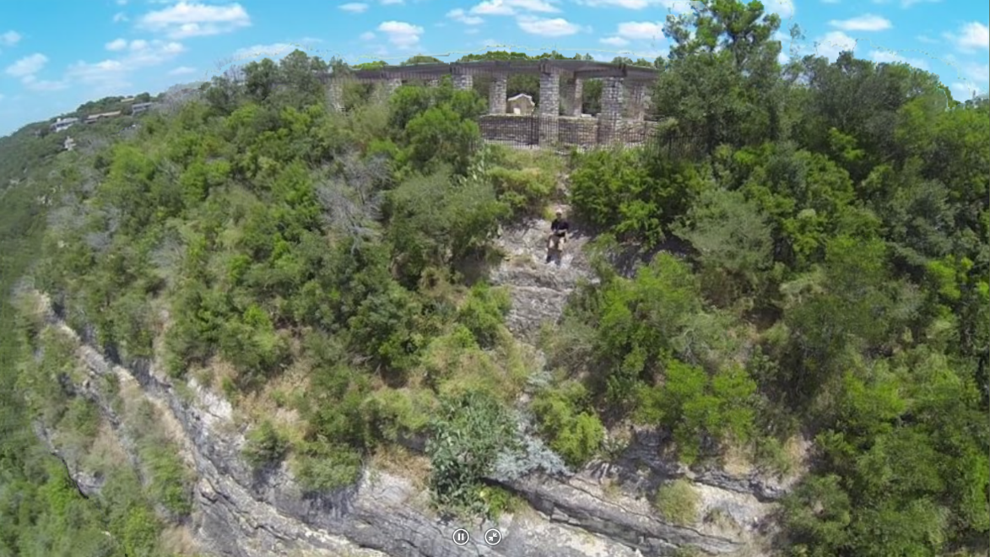
Assignment #10: Pictures of Space (2)
Photosynth 3D of HOPE Outdoor Gallery, 21 photos.
Photosynth 3D at Mount Bonnell, 22 photos.

Slide 13

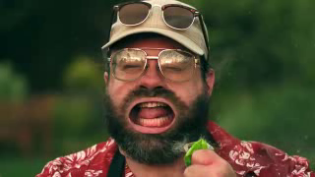
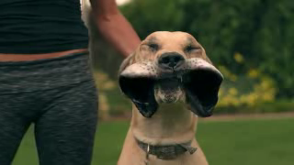

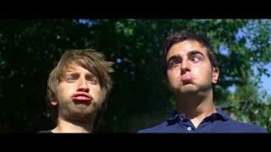
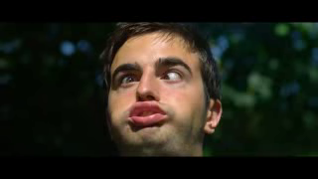
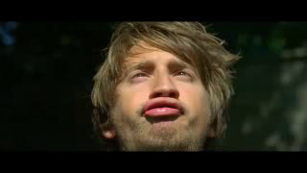

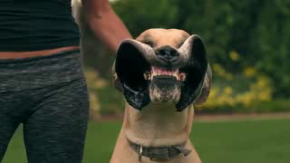
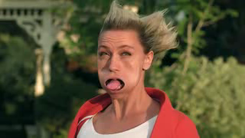
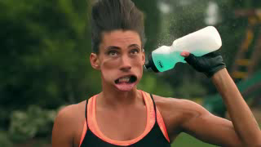

Assignment #11: Video Textures
Inputs:
Outputs:
GIFs:
alpha=2.5E6
alpha=1.5E6
alpha=1.5E6

Slide 14
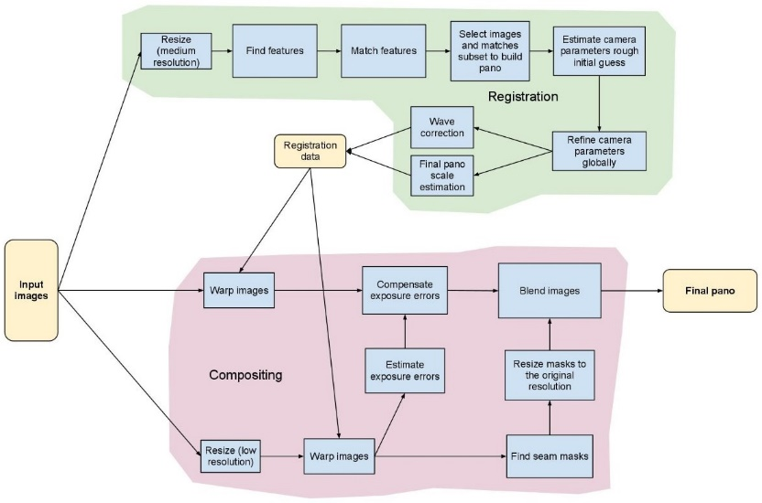
Final Project
The goal of this solo project was to computationally combine bokeh and panoramic photography to achieve a bokeh panorama, also known as the Brenizer Method. This technique utilizes panoramic stitching to create stunning portraits with a shallow depth of field and wide angle of view. The final result looks like a picture taken with a very large sensor and/or a very fast lens (aperture < f/1).
Process:
Input
Stitch
Crop
Output

Slide 15
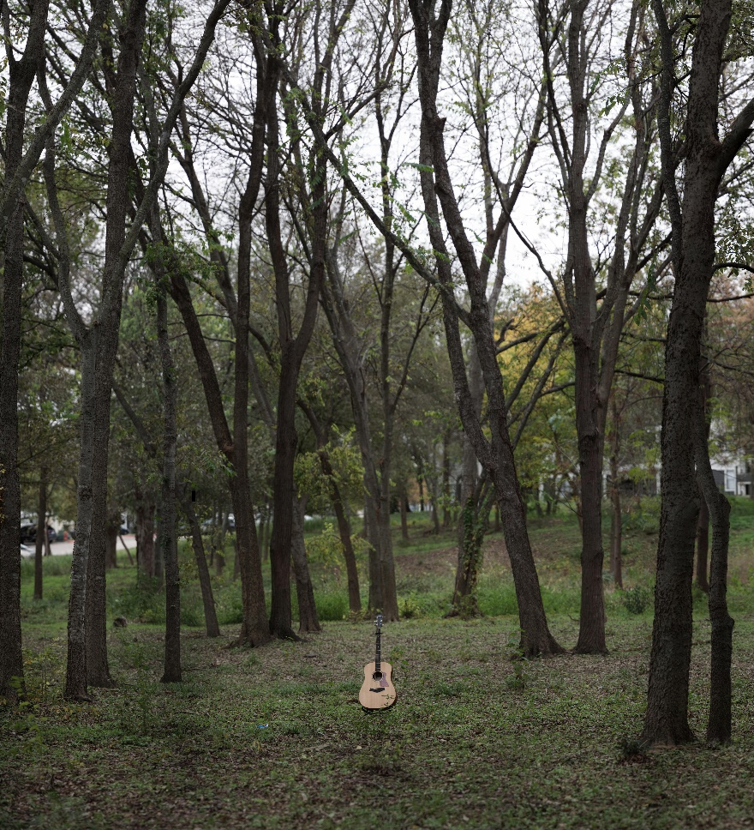
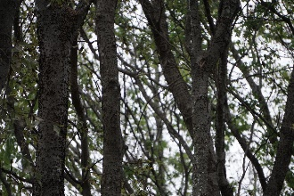
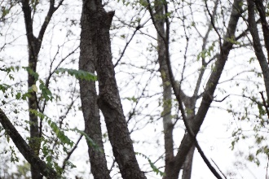
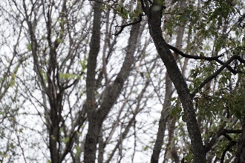
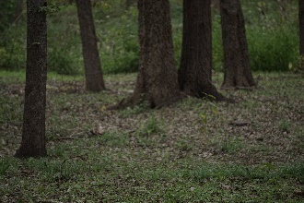
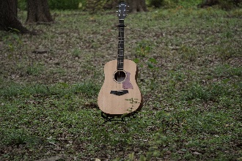
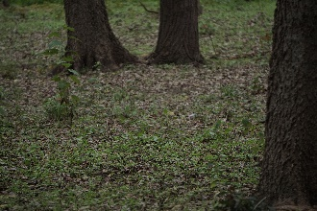



Final Project (2)
Output
Input

Slide 16


Final Project (3)
Here are more of my results:
Between Two Trees (49 image bokeh panorama)
If a Guitar Falls in a Forest (99 image bokeh panorama)
Cloudy Hat (31 image bokeh panorama)
Saw on Fence (8 image bokeh panorama)
Full resolution cropped outputs:
https://drive.google.com/folderview?id=0B-9-oKYR8vK2TUd0LVZhdkx2TDA&usp=sharing

Slide 17
Thank you.

